Slide 1
TASK 3 – Data Insights
And Presentation

Slide 2
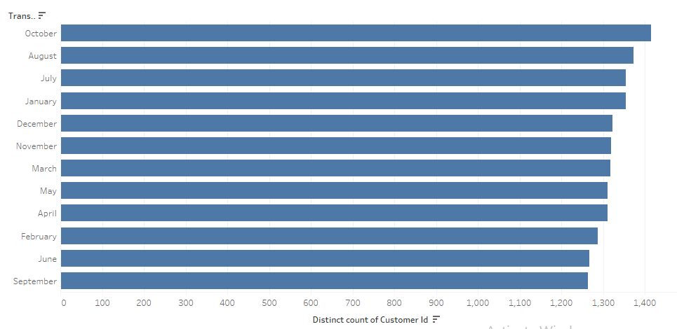
The below graph shows the distinct count of customer id for the transaction month i.e., which month attracts the highest number of customers.

Slide 3
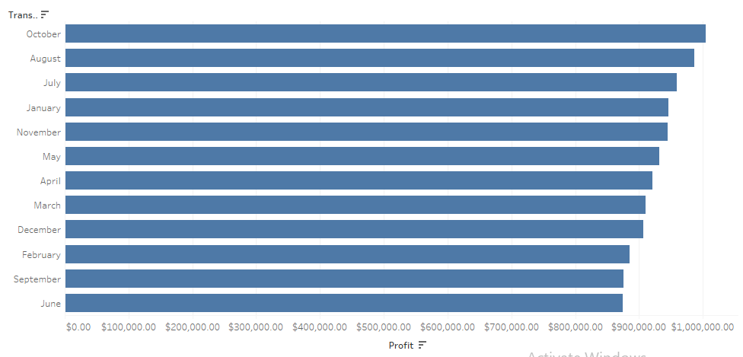
The below graph shows the total profits for the transaction month i.e., which month provides us with the highest profit.

Slide 4
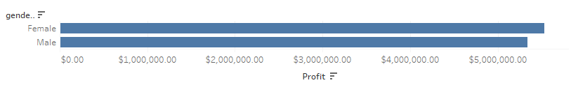
The below graph shows the total amount of profit for each category of 'gender'.

Slide 5
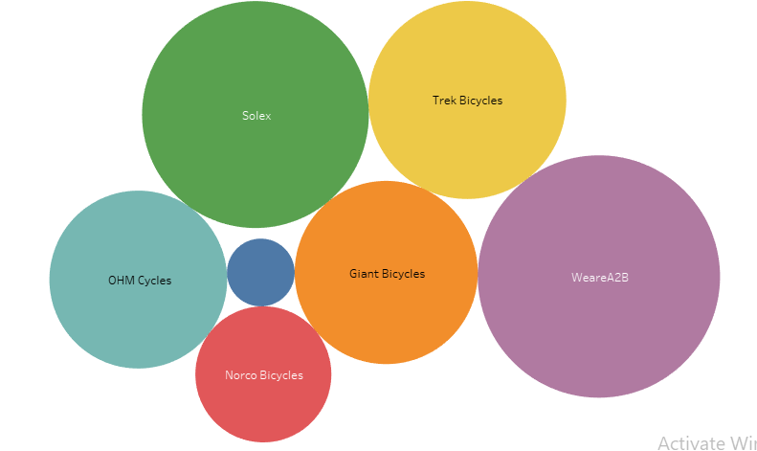
The below graph shows the distribution of each brand w.r.t total profit each brand provides. Higher the diameter of circle, higher the total profit.

Slide 6
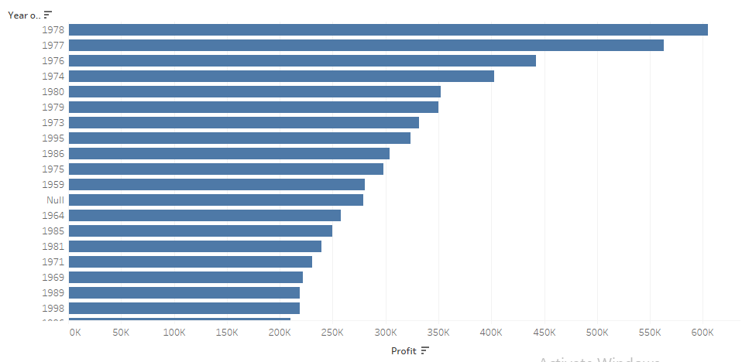
The below graph shows the total profit of each year of the date of birth of the customer i.e., which year gives more profit.

Slide 7
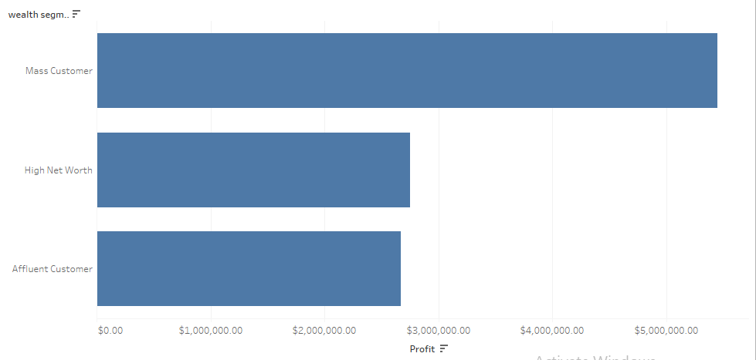
The below graph shows the total profit for each category of 'wealth segment', which yields more profit i.e., Mass Customer.

Slide 8
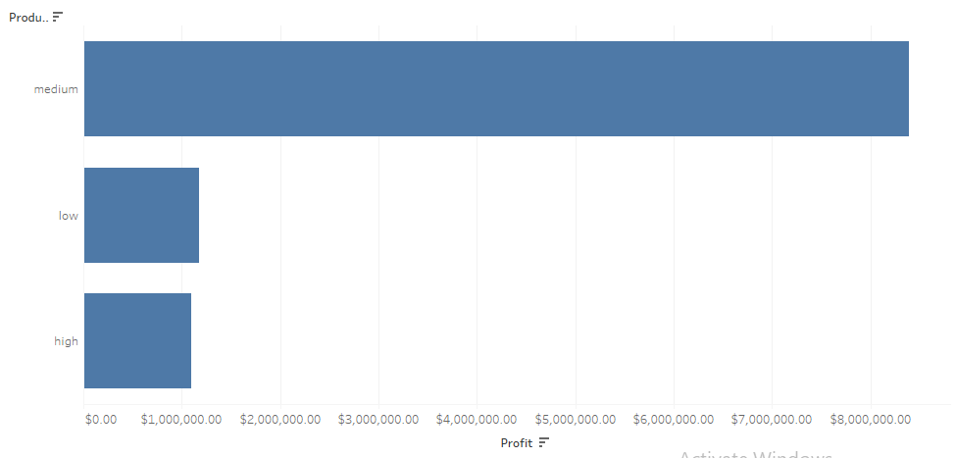
The below graph shows the total profit for each 'Product Class' category i.e., which category should be more focused on, which is medium product class.

Slide 9
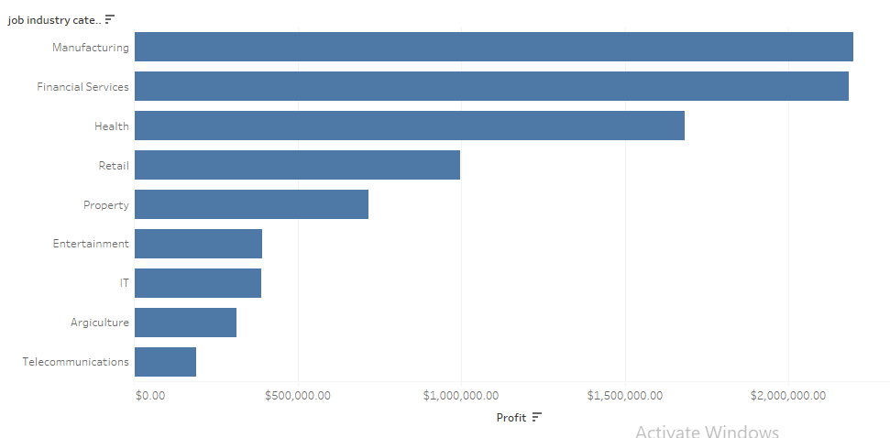
The below graph shows the total profit for each of the 'Job Industry' category. As visible, Manufacturing industry yields more profit followed by Financial services.

Slide 10
THANK YOU

